Slide 1

Welcome to Integration

Slide 2

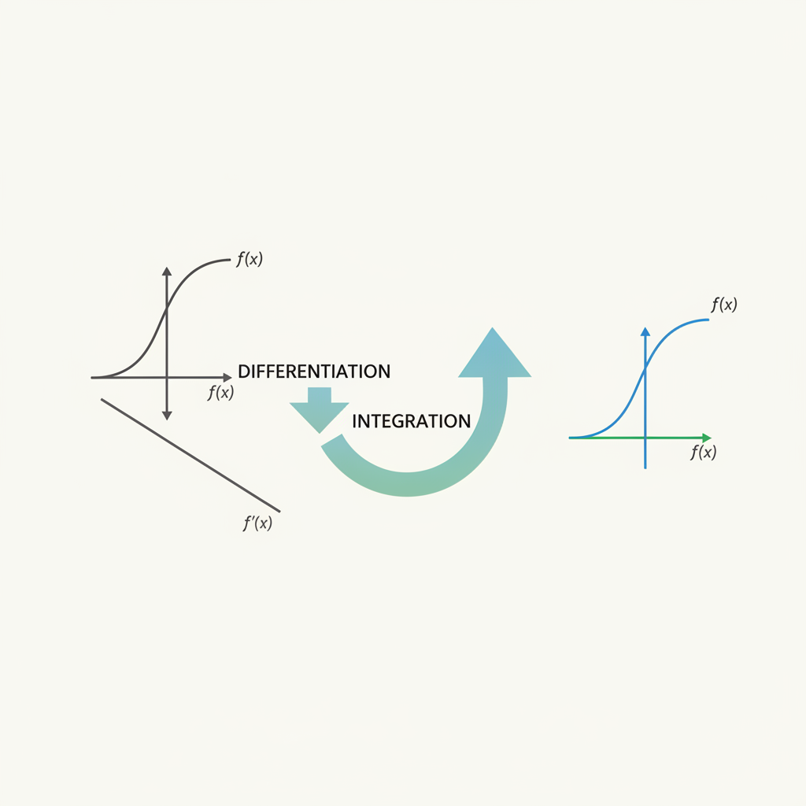
What is Integration?
Integration is essentially the reverse process of differentiation. If we know the derivative of a function, integration helps us find the original function.
It is also known as finding the antiderivative or primitive of a function. The constant of integration, denoted by C, is always added because the derivative of a constant is zero.
Integration: The Inverse of Differentiation

Slide 3
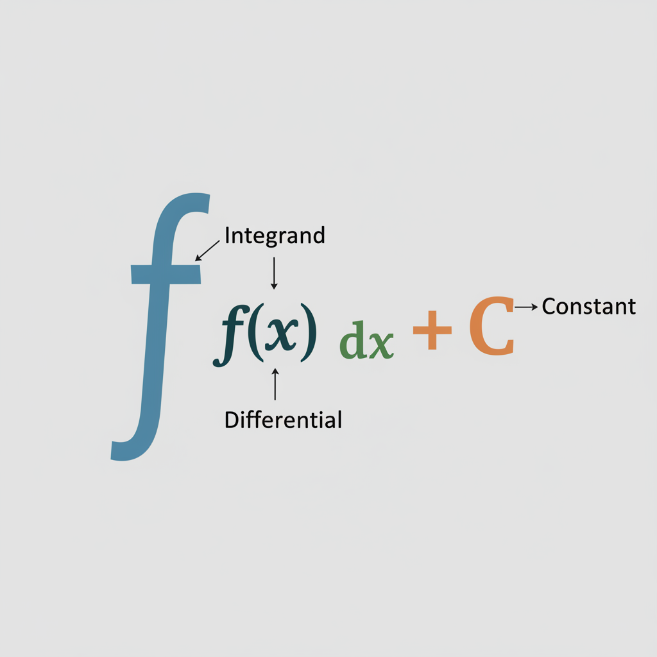
Indefinite Integral
The indefinite integral of a function f(x) with respect to x is denoted by ∫f(x) dx. Here, the symbol ∫ is the integral sign, f(x) is the integrand, and dx indicates the variable of integration.
If F(x) is an antiderivative of f(x), then ∫f(x) dx = F(x) + C. This expression represents the family of all antiderivatives of f(x).
Components of an Indefinite Integral

Slide 4
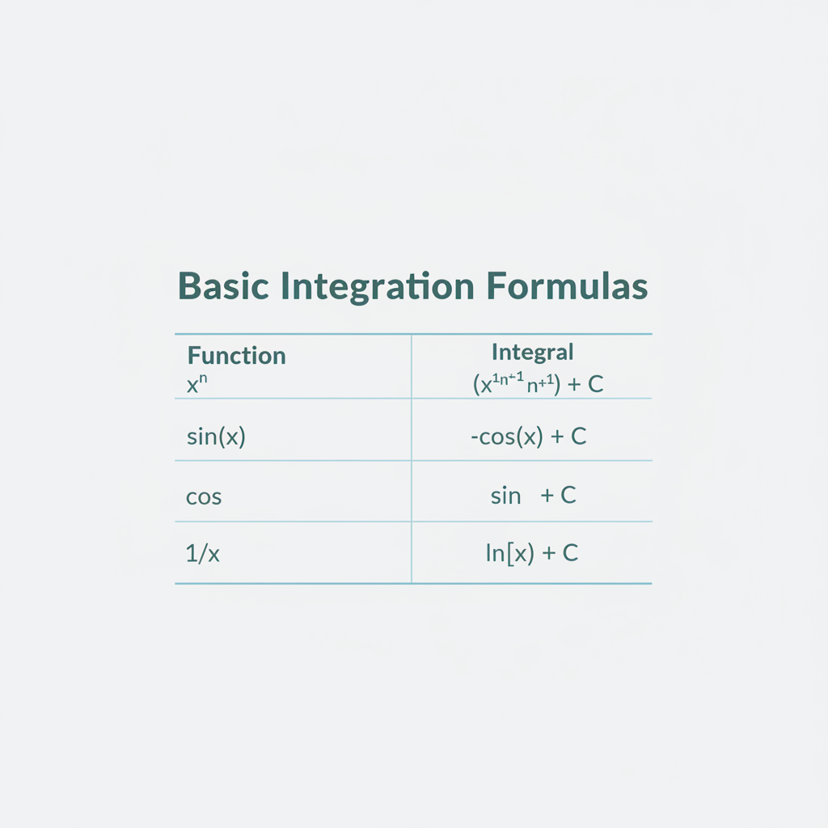
Basic Integration Formulas
Some fundamental formulas are essential for integration. For example, ∫xⁿ dx = (xⁿ⁺¹)/(n+1) + C, where n ≠ -1.
Other common integrals include ∫cos(x) dx = sin(x) + C and ∫sin(x) dx = -cos(x) + C. These formulas are directly derived from differentiation rules.
Key Formulas for Indefinite Integrals

Slide 5
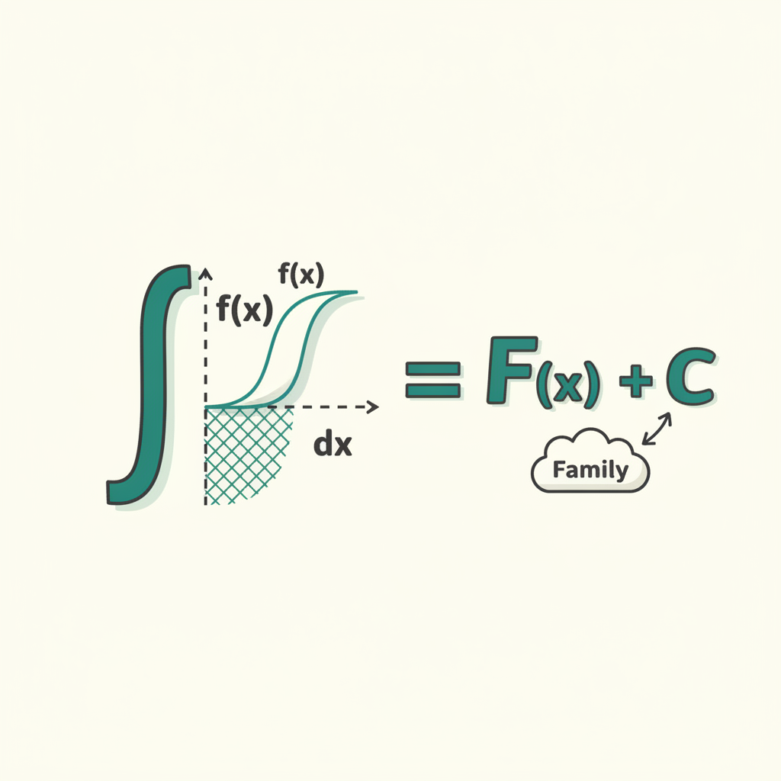
Properties of Indefinite Integral
The integral of the sum or difference of functions is the sum or difference of their integrals: ∫[f(x) ± g(x)] dx = ∫f(x) dx ± ∫g(x) dx.
A constant factor can be taken out of the integral sign: ∫k f(x) dx = k ∫f(x) dx, where k is any real number. These properties simplify complex integration problems.

Slide 6
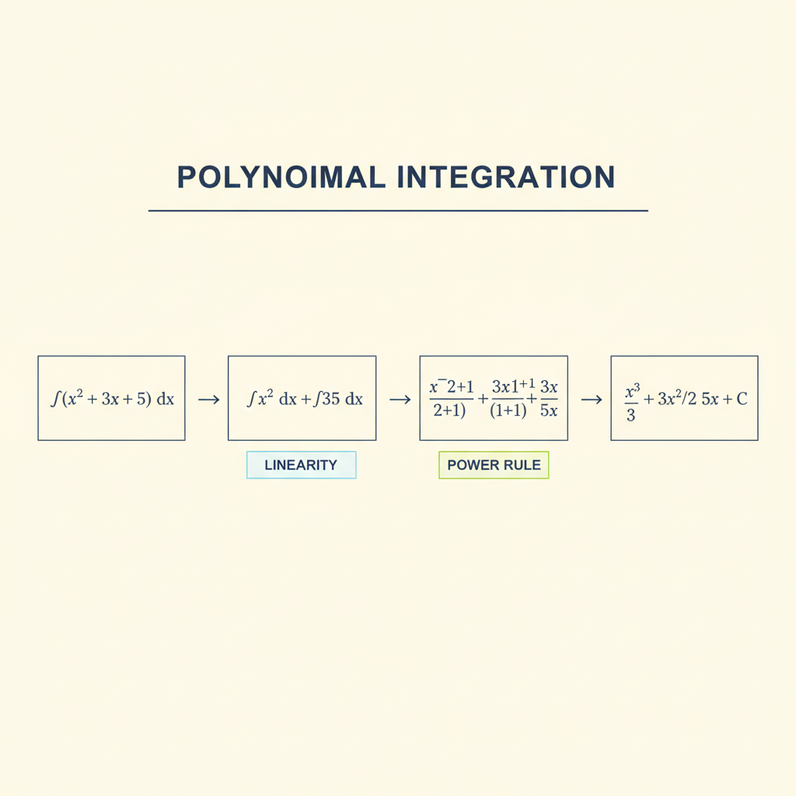
Worked Example: Power Rule
Problem: Find the indefinite integral of ∫(x² + 3x + 5) dx.
Solution: Using the power rule and linearity, we integrate each term separately. ∫x² dx = x³/3 + C₁, ∫3x dx = 3x²/2 + C₂, ∫5 dx = 5x + C₃.
Combining these, we get (x³/3) + (3x²/2) + 5x + C, where C = C₁ + C₂ + C₃. This demonstrates the application of basic rules.
Step-by-Step Integration Example

Slide 7
Geometric Interpretation
Geometrically, an indefinite integral represents a family of curves. Each value of the constant of integration C corresponds to a specific curve shifted vertically.
These curves are parallel to each other in the sense that their tangents at any specific x-coordinate are parallel, meaning they have the same slope, or derivative, f(x).

Slide 8
Key Takeaways
Integration is the inverse of differentiation.
Indefinite integral represents a family of functions F(x) + C.
Basic formulas and properties help simplify integration.

